Slide 1
(Mis)uses of notebooks as production tools in the financial industry
Fedor Gorokhovik, AHL (Man Group)

Slide 2

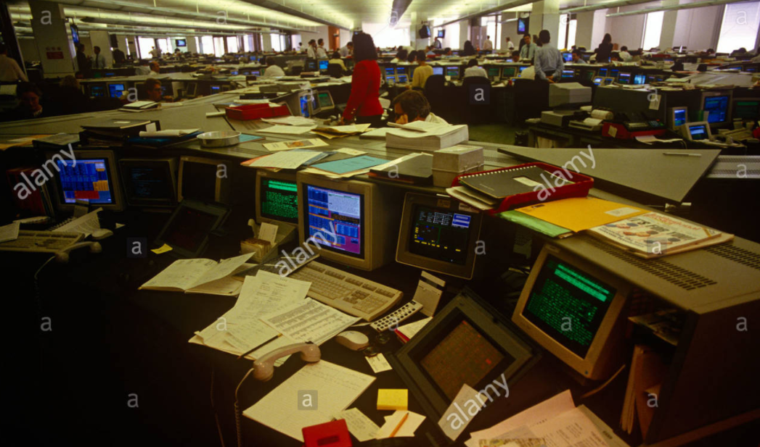
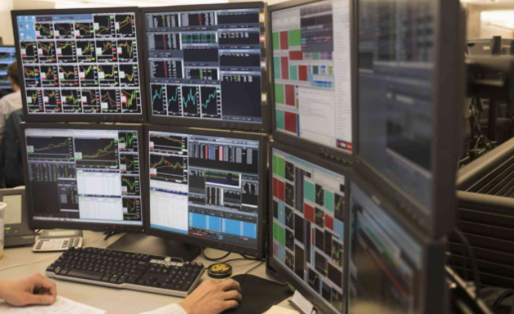
Evolution of technology in finance

Slide 3

Tabular data (Time series) with easy arithmetic
Excel
Good:
Intuitive & easy
Can do advanced stuff
Easy to automate
Reproducible
Graphs
Ultra fast prototyping (unmatched)
Bad:
Cannot fit that much data
Slow & clunky for large sheets
Visualization is horrendous
Systems need to connect with Excel
Jupyter
Good:
Intuitive & easy
Reproducible
Sick graphs!
Can do even more advanced stuff
Packages!
Easy to automate
Fast prototyping
Most systems are either in python or easy to interface
People can say “I code”
Bad:
Rather annoying to do complex graphs
So tempting to make it a prod tool that people do

Slide 4
Overreliance on these interfaces lead to $ losses
In 2003, TransAlta lost $24 million due to Excel copy-and-paste error
In 2005, Kodak suffered an $11 million severance error due to Excel typo
In 2010, MI5 bugged the wrong phones due to a spreadsheet formatting error
In 2012, JP Morgan was hit with $6 billion trading loss due to Excel copy-and-paste error
The IMF took policy decision because of the conclusion of an article with an Excel mistake
Nothing reported because of Jupyter (yet)
Reference:
https://www.teampay.co/insights/biggest-excel-mistakes-of-all-time/
https://www.theguardian.com/politics/2013/apr/18/uncovered-error-george-osborne-austerity

Slide 5
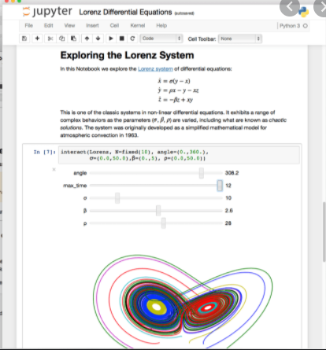
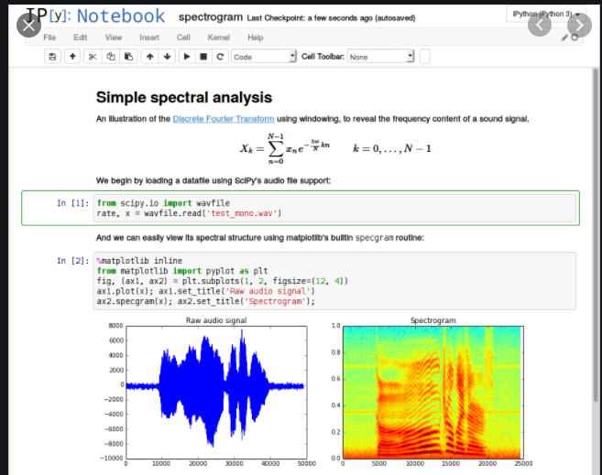
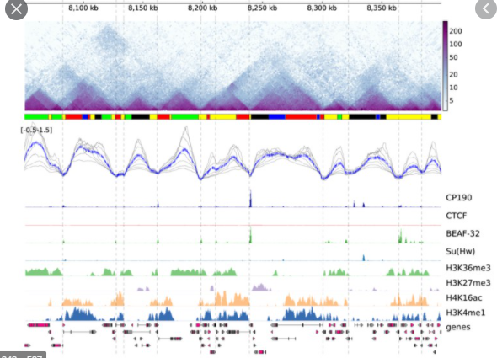
WHY did jupyter come to prominence?
Competition vs R, Matlab, now Julia. Initially, Jupyter was a pure exploratory data analysis tool, then Spyder was for small scripts, and Pycharm was for proper software development. Then Jupyter cannibalized Spyder’s spot and final blow with Jupyterlab. Why?
Save code-annotated pictures forever (what’s the alternative? Saving jpeg files? Latex? Not even sure)
Often direct interface to underneath systems (banking, but also e-commerce, any industry really)
Functions as a program with local variables, full power of python. Jupyterlab bridges with proper scripts

Slide 6
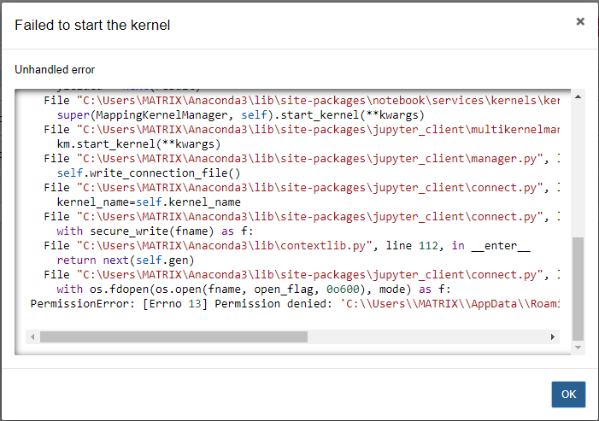
Where did it all go wrong?
Research and data analysis is great but… Code used to make decisions impactful for business need to be debuggable, reproducible, easy-to-deploy, high-performance. Everything research code on Jupyter isn’t.
Can’t remember if I need to run cell #78 before cell #13 to get to that result?
Often non reproducible environment (that can be fixed through venv)
Dirty code – code duplication, bugs, who is pep8
Pretty insane memory leaks
Underneath code change so shelf life is about 2 months
“Let me just save this notebook in case” and a few months later you have hundreds of broken notebooks
What tests?
The issue is that it’s so close to actual code that people build reliance on it without most software robustness practices.

Slide 7
Uses of notebooks in financial institutions
Previously financial institutions (but many other industries too) have one software for visualization, one for accessing and reading some database (maybe SQL), one to input, one to be able to price securities, etc. You would export data into Excel and make transformations, joins, graphs, etc there.
Jupyter solved all of this, as it’s easy to interface and integrate things into Python (and arguably it’s not the worst language to build systems).
Tool used in financial institutions to research, analyze and generally make quantitative decisions by anyone who can code. Scenarios:
Analyze some market data
Build a custom dashboard
Price a complex transaction for a client
Research a new signal or test a strategy

Slide 8
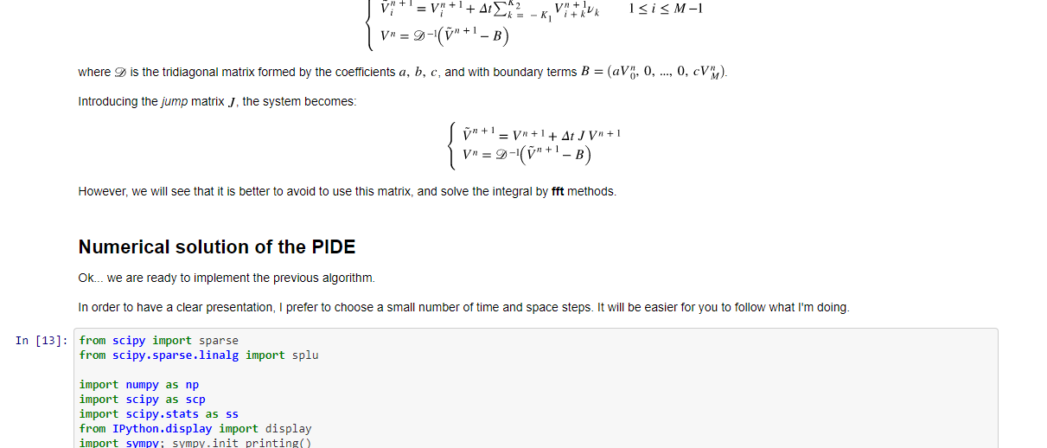
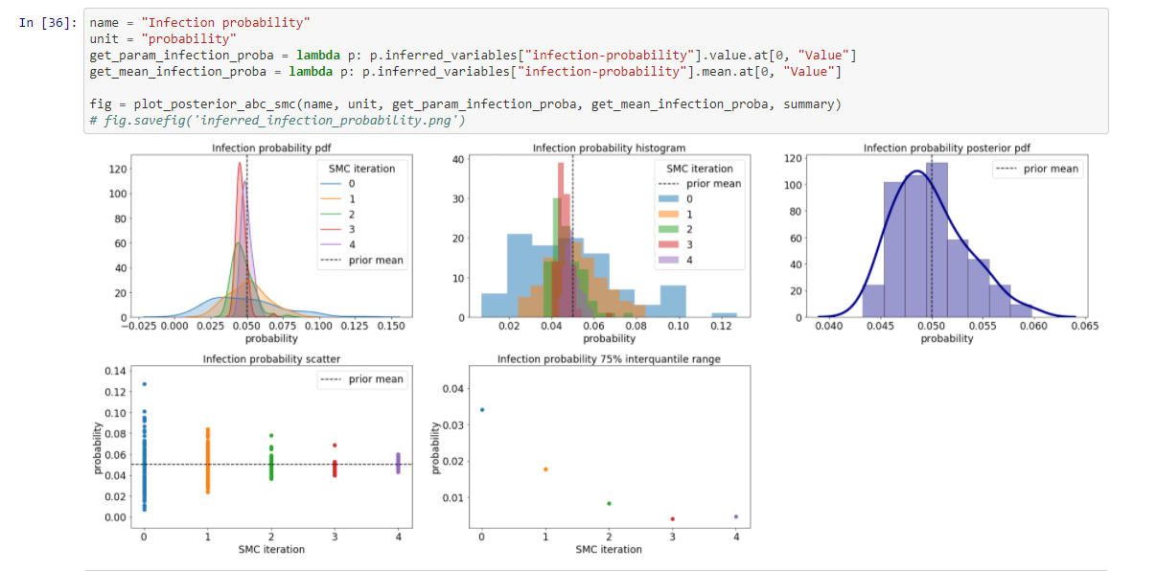
Examples: COVID modelling and financial numerical methods
https://github.com/cantaro86/Financial-Models-Numerical-Methods
https://github.com/ScottishCovidResponse/simple_network_sim/blob/master/doc/notebooks/Inference%20-%20ABC%20SMC.ipynb

Slide 9
Thank you very much for listening
Any question?
Conclusion: it’s a necessary evil

